Slide 1

Lenawee County Databook
LENAWEE COUNTY’S STORY IN DATA // 2025

Slide 2
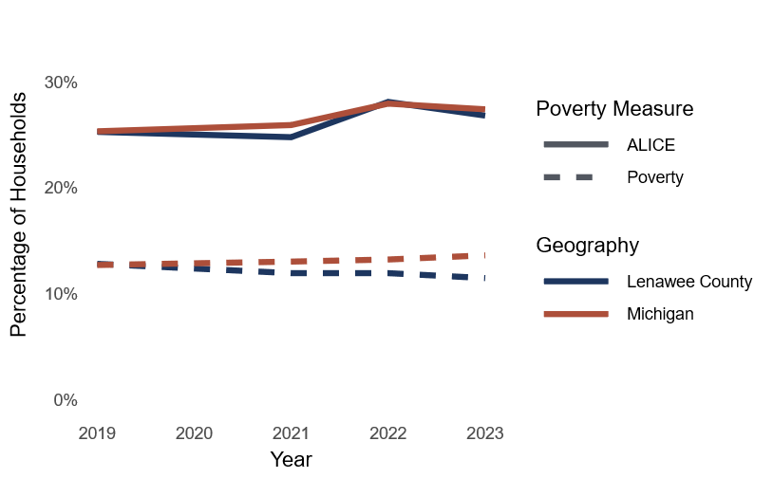
ALICE & Poverty Estimates Match State Trends
Figure 1. Percentage of households in poverty and considered ALICE in Lenawee County and Michigan, 2019–2023
Notes:
There are several ways that economic security and poverty are measured. ALICE is a methodology that represents the growing number of families who are struggling to meet their basic needs (United Way of Northern New Jersey, 2025). Federal poverty rates are a different way to measure economic status by estimating the monetary income of households by family sizes and compositions and are typically collected by the U.S. Census Bureau. Both measures use U.S. Census Bureau data, among other reliable sources, but communicate different measures of economic security or insecurity.
While costs for some basic needs in Lenawee County are rising, poverty rates and ALICE household rates are relatively stable. Estimates place just over one quarter (27%) of households in Lenawee County within the ALICE group, and this is the same rate as for the state of Michigan (Figure 1). Lenawee County and state-level poverty rate estimates are slightly different, with Lenawee County showing a 11% poverty rate, which is lower than the state rate of 14% (U.S. Census Bureau, 2019-2023a). Most of the financially strained individuals in Lenawee County are not actively living in poverty but may be living paycheck to paycheck depending on their financial circumstances. Over time, Lenawee County appears relatively stable and on track with the state in terms of overall financial strain rates; however, the degree to which economic strains are felt varies from place to place and from person to person.

Slide 3
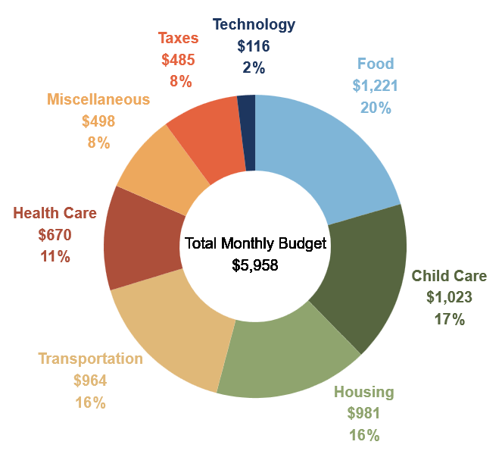
Half of Lenawee County Households May be Struggling to Afford Basic Needs
Figure 2. Household monthly survival budget for two-parent, two-child (in childcare) household in Lenawee County, 2023
Notes:
A "household survival budget" is a way to measure what the estimated minimum cost a household would pay in today’s economy to make ends meet. This measure is used to determine which households are below or above the ALICE threshold. While this measure uses the best available data to calculate its estimates, it is important to remember that some people may not see these estimates reflected in their daily reality. As with all data aggregations, these measures are often calculated using estimated averages, which do not account for the variation in individual lived experiences.
According to ALICE measures, in 2023, the survival budget for a two-parent two-child household with both children in childcare in Lenawee County was $5,324 per month or $63,888 per year (Figure 2) (United for ALICE, 2023). If we look at median household income in 2023, which was estimated by the U.S. Census Bureau to be $67,013 annually, we can conclude that, if they fit the profile of a two-parent two-child household with both children enrolled in childcare, half of families in Lenawee County would not have much of a buffer in income should an emergency arise (2019-2023b).

Slide 4
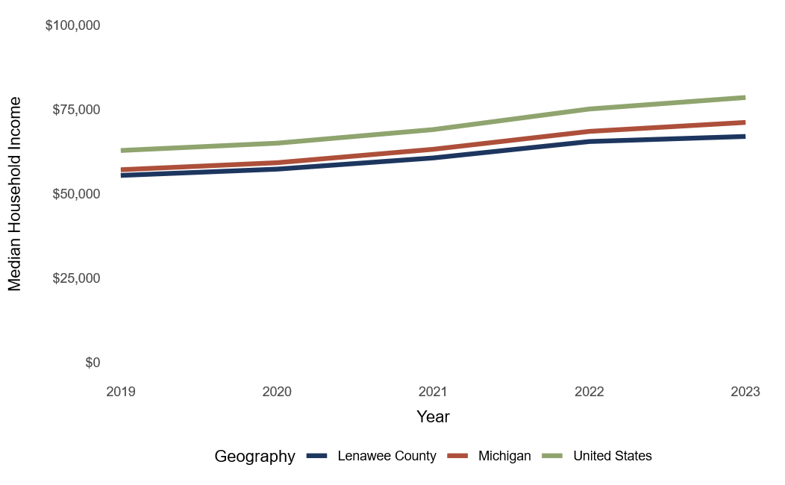
The Household Income Gap is Widening
Figure 3. Median household income, 2019–2023
Notes:
Household income estimates are used by the U.S. Census Bureau to determine the economic status of families in the U.S. (Income and earnings, 2025). These estimates are typically adjusted to account for inflation. The variables used to measure household income include:
earnings in wages or salary, interest, dividends, or net rental income
social security and supplemental social security income
public assistance income
retirement income
other types of income
Even though household income estimates are steadily rising, the gap between household income in Lenawee County compared to both the state of Michigan and the United States is widening. The median household income in Lenawee County is estimated to have increased by 20.8% from 2019 to 2023 (see Figure 3). In those same years, median incomes rose 24.9% nationally and 24.5% at the state level (U.S. Census Bureau, 2019-2023b). This means that Lenawee County’s median household income is growing at a slower rate than the state or nation, and this has ramifications for Lenawee County’s overall economic growth.

Slide 5
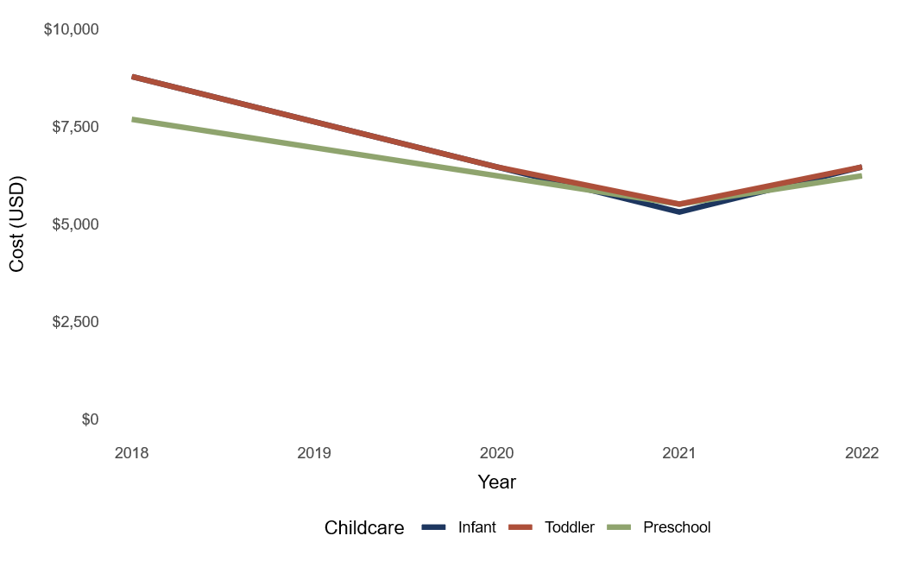
Lenawee County Childcare Costs Less Than the U.S. Average
Figure 4. Average cost of center-based childcare in Lenawee County (USD), 2018–2022
Notes:
Costs for childcare relative to income are rising over time, with families spending on average 8.9% to 16% of their median income for a full-day care for one child in the U.S. (U.S. Department of Labor, 2018-2022). In general, families pay more for home-based childcare than center-based childcare, but there can be variability. The cost for childcare depends on whether the care is part-day or full-day, and the ages of the children.
Data indicates that costs of center-based childcare for all ages in Lenawee County declined from 2018-2021 and rose again in 2022. The percentage (%) change from 2021 to 2022 ranges from 13% to 22%, depending on the child’s age. The median yearly price of center-based childcare for one child in Lenawee County in 2022 was estimated to cost $6,469 for an infant, $6,469 for a toddler, and $6,240 for a preschooler (U.S. Department of Labor, 2018-2022). This means that half of Lenawee County families with one child in center-based childcare would spend less than the median cost, and the other half would spend more than the median cost. The average annual cost of center-based childcare by age group in Lenawee County is visualized in Figure 4 (in USD), though some families or individuals will experience costs that diverge from the stated averages.

Slide 6
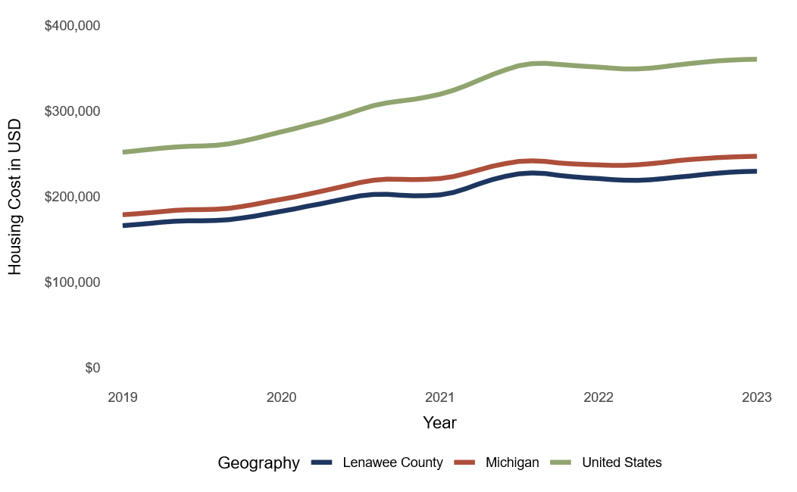
Home Prices are Rising Steeply in Lenawee County
Figure 5. Average home price trends comparison, Lenawee County and Michigan, 2019–2023
Notes:
Residents, city leaders, and county leaders are aware of the state of housing and are concerned about the lack of quality and affordable housing options throughout Lenawee County, particularly in the south and southwest areas. In a survey conducted by Housing Lenawee in 2023, 100% of respondents representing county-, city-, village-, and township-level professionals indicated a need for new housing, while 83.3% indicated a need for funding to rehabilitate existing housing (Sprague et al., 2023). Even so, 66.7% of respondents shared that they lack the capacity to write and administer grants for housing rehabilitation and construction of new units (Sprague et al., 2023). Rising home prices for both renters and homeowners are a state and national phenomenon — and prices for housing often outpace income growth.
Housing prices in Lenawee County have followed state and national trends while remaining below state and national averages. Housing prices across all geographies rose steadily from 2012 to 2020, after which prices increased more sharply following the COVID-19 pandemic. Since 2023, housing prices have continued to increase, but at a slower rate than the period from 2020–2023.
Additionally, while housing prices in Lenawee County have remained below state and national averages since 2000, price differences between Lenawee, Michigan, and the U.S. have changed over time. In 2012, the average home in Lenawee County cost about $3,000 less than the average home in Michigan, and about $67,500 less than the average home in the U.S. Today, even as home prices across all geographies have increased, the average home in Lenawee County costs $25,390 less than the average home in Michigan, and $131,466 less than the average home in the U.S. (Figure 5) (Zillow, 2019-2023).

Slide 7
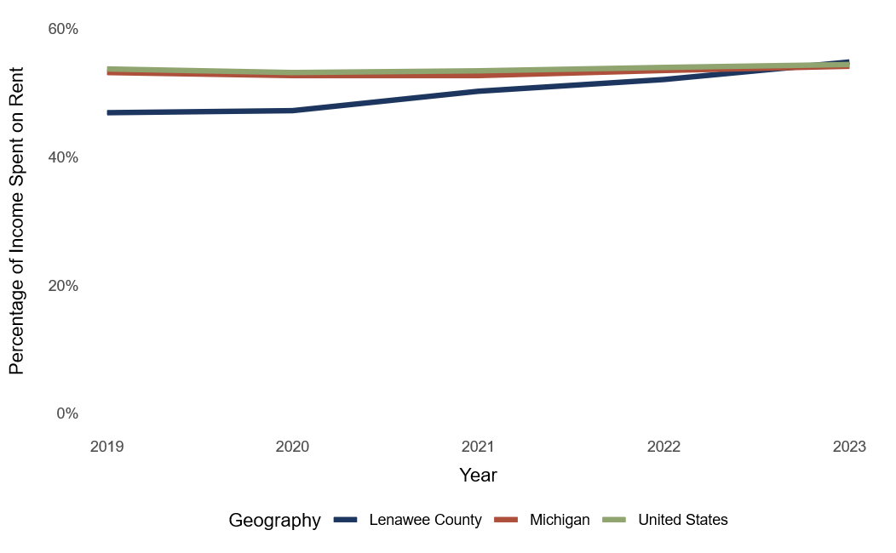
Higher Shares of Income are Spent on Rent
Figure 6. Share of renters spending 30% or more of their income on rent (%), 2019–2023
Notes:
According to the U.S. Department of Housing and Urban Development (HUD), individuals should spend no more than 30% of their income on housing. In 2023, half (50%) of renters in the U.S. spent 30% or more of their income on rent (U.S. Census Bureau, 2019-2023c). This metric is a key indicator that determines a person’s or household’s ability to afford living in a home, and the degree to which their income spent on rent is too high and unsustainable long term.
Lenawee County was below both the state and national rates of the number of people exceeding the 30% threshold in 2019. However, as of 2023 that number has risen 5% and appears to be increasing at faster rate than the state or national averages. Given the housing-stock shortages and increasing numbers of individuals experiencing homelessness in the county, this is an important metric to monitor as an indicator of housing affordability — especially as it relates to other costs of living and incomes.

Slide 8
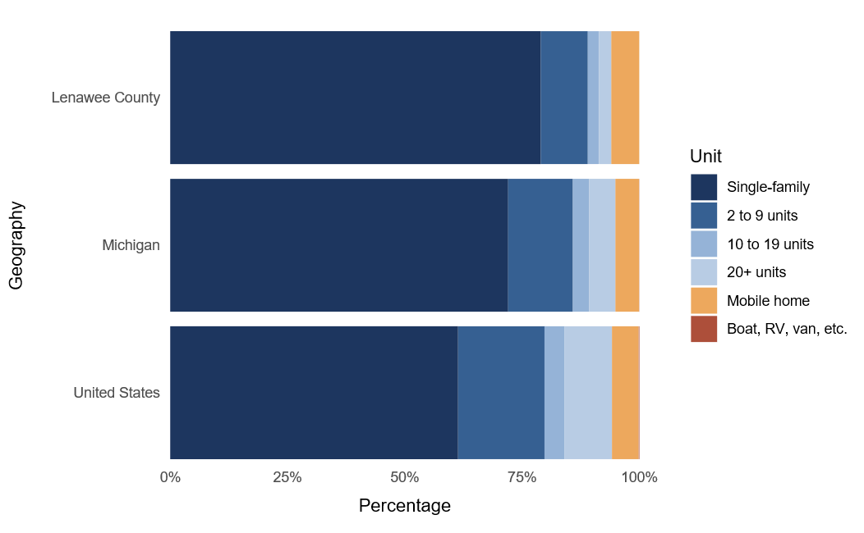
Lenawee County Lacks Housing to Meet Needs
Figure 7. Stock of housing types in Lenawee County, Michigan and U.S., 2023
Notes:
According to the State of Michigan’s Housing Needs Assessment, an “adequate” housing supply ideally serves a range of households with a variety of housing type options, such as single-family homes for sale or apartments for rent (2025). In 2020, there were 43,577 housing units in Lenawee County (HR&A Advisors, 2025). Of the 38,581 occupied units, 79% were owner-occupied while 21% were renter-occupied in 2023 (HR&A Advisors, 2025). The rate of ownership is higher than both the state and national averages (see Figure 7).
When it comes to housing stock type, single-family homes made up 79% of the stock, while 15% were multi-family units, meaning households have a limited variety of accessible, affordable housing options to choose from (U.S. Census Bureau, 2019-2023c). Among vacant homes in Lenawee County, roughly 50% of them are used seasonally, meaning these homes are unoccupied for most of the year (HR&A Advisors, 2025).

Slide 9
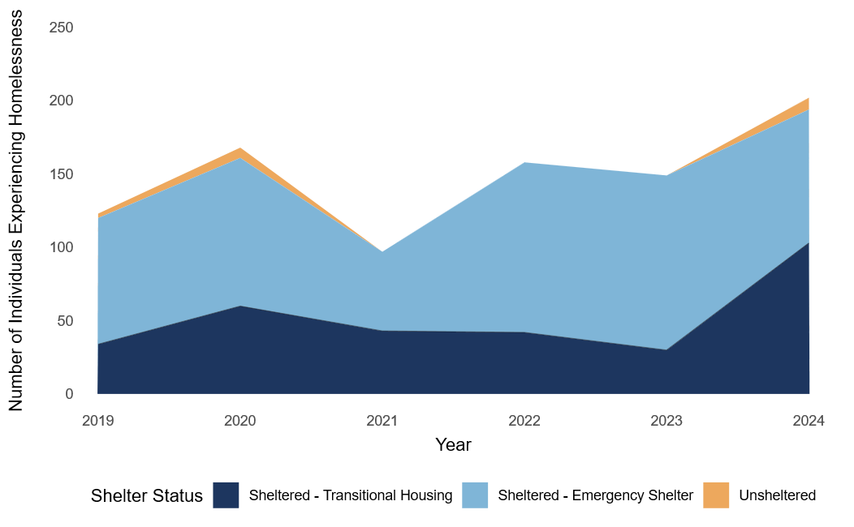
The Number of Individuals Experiencing Homelessness is Rising
Figure 8. Number of individuals experiencing homelessness, Lenawee County, 2019–2024
Notes:
The U.S. Department of Housing and Urban Development’s report, The 2024 Annual Homelessness Assessment Report (AHAR) to Congress: Point In Time Count, shares that nearly all populations reached record levels of homelessness among people in families with children, individuals, individuals with chronic patterns of homelessness, people staying in unsheltered locations, people staying in sheltered locations, and unaccompanied youth (2024). Housing insecurity is caused by many factors, such as the lack of affordable housing options, insufficient income/government benefits relative to the cost of living, health conditions, and systemic barriers. With rising home prices and rent and a lack of options, an increase in the number of individuals experiencing homelessness is to be expected. Yet since focusing on solutions could help alleviate this trend, the Lenawee County Housing Strategic Plan has actionable recommendations for cities, townships, and villages that might help ease these strains.
The AHAR report indicates that the number of individuals experiencing homelessness in Lenawee County increased 64.2% from 2019 to 2024 (see Figure 8) (U.S. Department of Housing and Urban Development, 2019-2024). In the same time frame, the U.S. experienced a 35.9% increase, which means the rate at which the number of individuals experiencing homelessness is increasing in Lenawee County is higher than the national average (Henry et al., 2024).

Slide 10
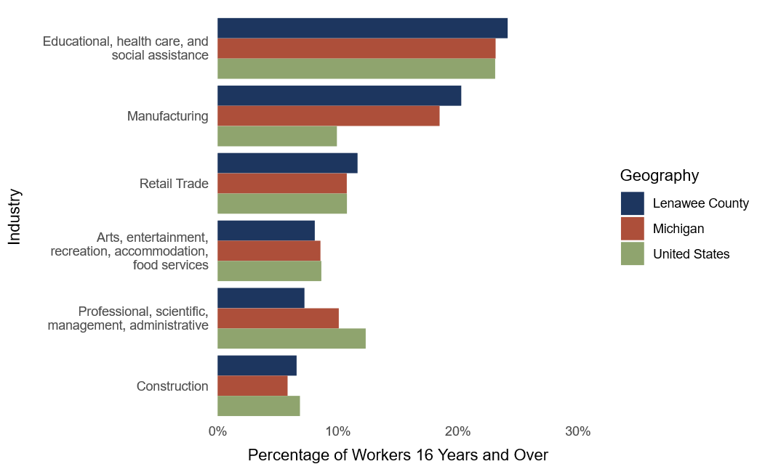
Large Institutional Closures May Impact Employment
Figure 9. Civilian employment by industry for individuals aged 16 and older, 2023
Notes:
Michigan’s overall employment levels have been growing at a modest pace in the past two years. When it comes to employment, education, and health services, growth is expected to slow due to cuts to federal funding for Medicaid and other essential programs (Burton et al., 2025). Michigan’s manufacturing and retail trade sectors are expected to lose jobs in the next few years; however, researchers express a high degree of uncertainty in this forecast, as it is unknown how tariffs will impact jobs (Burton et al., 2025).
An estimated 24% of Lenawee residents 16 years of age and older are employed in educational, healthcare, and social assistance professions, and manufacturing is the second highest employment industry at an estimated 20% (U.S. Census Bureau, 2019-2023d). Recent announcements of the 2025 Budget Reconciliation Act and the closing of Siena Heights University may impact employment rates in the future, as hospitals around the country, specifically rural ones, are expected to close in the coming years due to budget cuts. In Michigan, rural hospitals are expected to experience just over $2 billion in impacts (losses) over the next 10 years, according to the American Hospital Association (2025). How and to what degree these budget cuts and potential hospital closures will affect Lenawee County directly remains to be seen; however, this trend will be important to monitor in the coming three to five years.

Slide 11
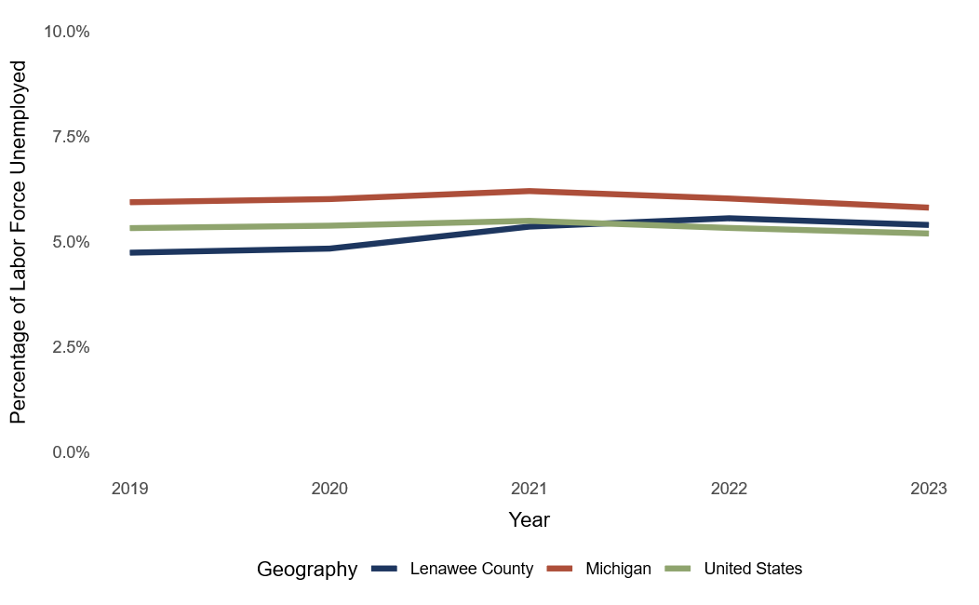
Unemployment Rates Add to Financial Strain
Figure 10. Unemployment rates, 2019–2023 for Lenawee County, Michigan, United States
Notes:
The closure of Siena Heights University may not cause a major shift in the county’s overall unemployment rate, which has stayed relatively stable in recent years (a 0.7% increase from 2019 to 2023) (U.S. Census Bureau, 2019-2023e). However, the loss of a long-standing educational institute may displace workers and reduce economic activity. Despite a slight rise in unemployment rates (see Figure 10), workshop participants expressed that residents are concerned about the local economy and their financial well-being. It is also concerning to see that the unemployment rates in Lenawee County and the state of Michigan are trending past the U.S. rates. The rising unemployment rates are possibly indicative of the difficulty of finding stable, long-term employment in both the state and county.

Slide 12
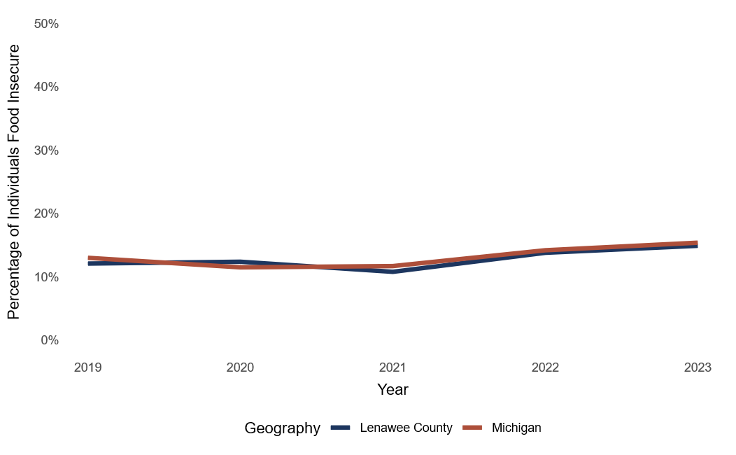
Food Insecurity Rates are Climbing in Lenawee County
Figure 11. Food insecurity rate, Lenawee County and Michigan, 2019–2023
Notes:
According to the United States Department of Agriculture (USDA), food insecurity is a household-level economic and social condition of limited or uncertain access to adequate food (Rabbitt, Hales, & Reed-Jones, 2025). Food insecurity is a spectrum, and people may experience it intermittently, depending on their financial situation. Experiencing economic hardships not only affects people in the present but can also have long-lasting effects. Many health conditions are influenced by one’s ability to access nutritionally dense foods and studies show food insecurity is associated with increased risk of developing heart disease (Jia & Carnethon et al., 2025). Furthermore, the availability of resources and benefits is not always widely known, or people may lack the resources or time to take advantage of the benefits available.
Lenawee County and the State of Michigan’s overall food insecurity rates have followed a similar trend from 2019 to 2023. The percentage of people who experience food insecurity in Lenawee County has increased by 2.8% since 2019 (Feeding America, 2019-2023). The largest decrease (10.8%) occurred in 2021, but the rate quickly increased by 3% in 2022 and continued to climb in 2023 (Figure 11). Aside from a slightly higher rate in Lenawee County in 2020 and 2021, food insecurity rates are climbing, though still slightly below the state’s rate.

Slide 13
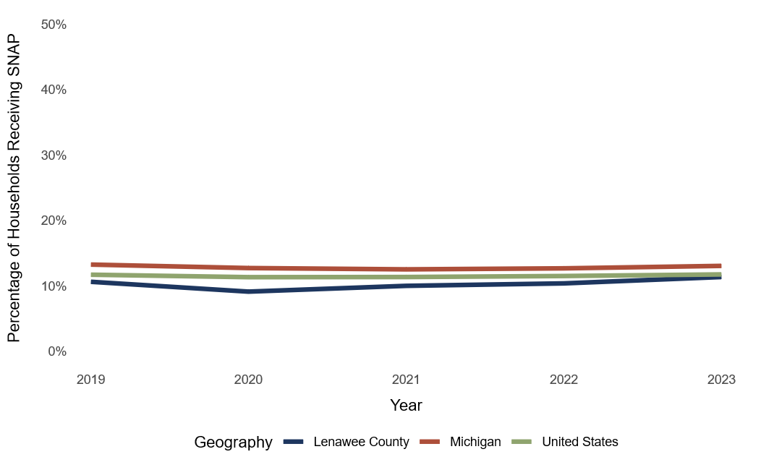
SNAP Enrollment Rates are Remaining Stable
Figure 12. Percentage of households receiving SNAP benefits (food stamps), 2019–2023
Notes:
The percentage of individuals enrolled in SNAP has remained relatively stable. In 2023, 11.4% of households in Lenawee County received food stamps/SNAP benefits, which is 0.8% greater than the rate in 2019 (Figure 12) (U.S. Census Bureau, 2019-2023f). Despite the slight variance over time, Lenawee County’s SNAP benefits enrollment estimates have fluctuated more than in the state of Michigan and the U.S. From 2019 to 2023, Michigan SNAP enrollment rates decreased by 0.2% and for the U.S., it increased by 0.1%. Given the food insecurity rate estimates, it is unclear why SNAP enrollment in Lenawee County is lower than in the rest of the state.
However, there are many factors to consider that could cause lower enrollment rates:
lack of time to enroll or access to enrollment
social stigma around benefits usage
lack of accurate data
other forms of food resources that are available, such as food banks
As of July 2025, Lenawee County had 20 food pantries, 4 fresh food distribution sites, and 4 soup kitchens serving residents across the county according to the Lenawee County Resource Guide. The number of food pantries in the county well exceeds (by 5x) the estimated national average number of pantries per 100,000 people in rural census tracts (3.79) (Riediger, Dahl, Biradar, & others, 2022).

Slide 14
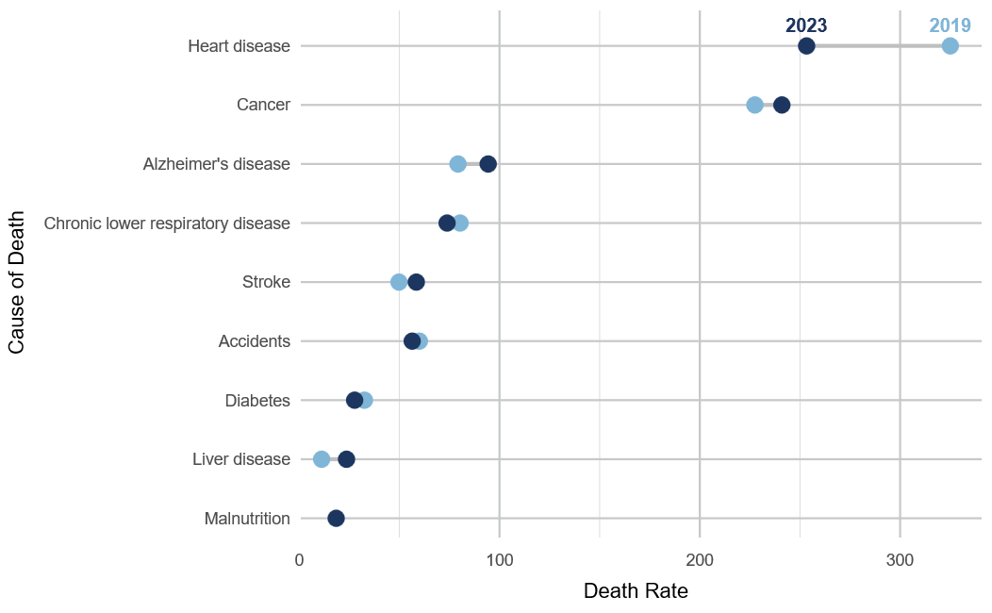
Heart Disease & Cancer are the Top Causes of Death in Lenawee County
Figure 13. Leading causes of death per 100,000 people in Lenawee County, 2019 and 2023
Notes:
The top two leading causes of death in Lenawee County are heart disease and cancer (U.S. Centers for Disease Control and Prevention, 2019-2023). Heart disease is a public health concern, but can be preventable through eating nutritionally dense foods, exercising, and not smoking (Mayo Foundation for Medical Education and Research, 1998-2025). When comparing the leading causes of death with the state of Michigan, Lenawee County has an increasingly higher rate of residents dying from Alzheimer’s disease. The rate of death by stroke is also rising at a faster rate in Lenawee County than in the state.
From 2021 to 2023, death rates in Lenawee County decreased for COVID-19, heart disease, chronic lower respiratory disease, accidents, and diabetes (see Figure 13) (U.S. Centers for Disease Control and Prevention, 2019-2023). In the same time frame, death rates in Lenawee County increased for cancer, Alzheimer’s disease, stroke, kidney disease, and liver disease. Compared to statewide estimates in 2023, Lenawee County had higher death rates attributed to cancer, Alzheimer’s disease, and chronic lower respiratory disease, and lower death rates attributed to heart disease, accidents, and COVID-19 (U.S. Centers for Disease Control and Prevention, 2019-2023).

Slide 15
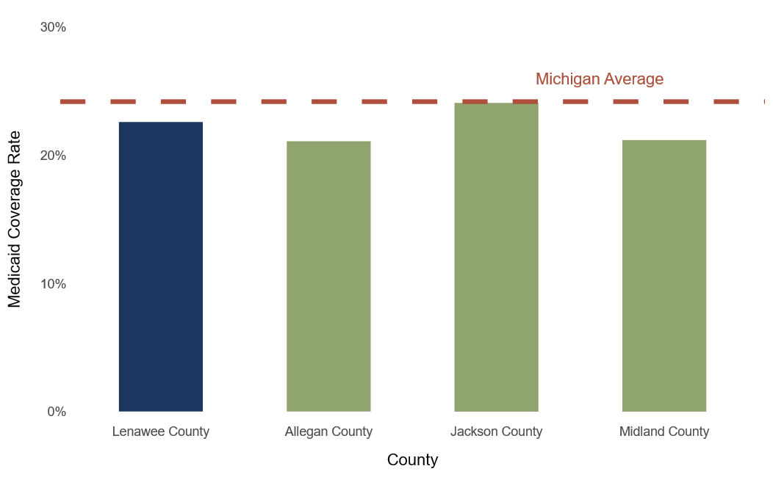
Federal Cuts Will Impact Coverage for Medicaid Enrollees
Figure 14. Percentage of Medicaid coverage rates, all populations enrolled, selected counties and Michigan
Notes:
In 2023, Medicaid covered an estimated 22.6% of the insured population in Lenawee County (see Figure 14), while it covered 24.2% overall in Michigan (Center for Children & Families, 2025). The Budget Reconciliation Act included federal cuts to Medicaid in addition to changing eligibility requirements that will take effect January 1st, 2027. In May 2025, the founder of ComForCare, an in-home provider that serves Jackson, Hillsdale, and Lenawee Counties, shared with news outlets that they considered turning away Medicaid users because of the anticipated Medicaid budget cuts (Udrys, 2025). The Michigan Department of Health and Human Services estimates that more than 500,000 Michiganders will lose coverage due to the new eligibility requirements (Johns Hopkins Bloomberg School of Public Health, 2025)). Furthermore, American Hospital Association (AHA) estimates 68,200 rural residents in Michigan are expected to lose Medicaid coverage through the year 2034 (2025).

Slide 16
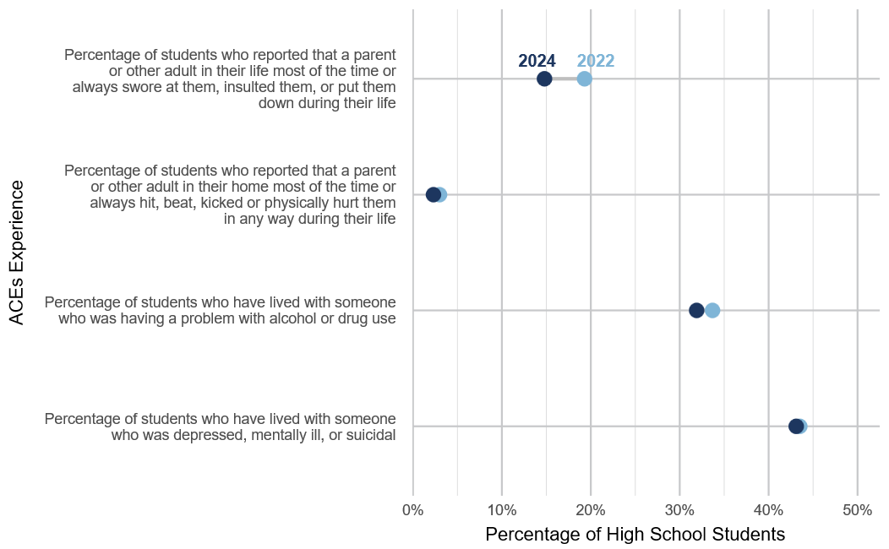
Adverse Childhood Experiences (ACEs) for Adults & Youth
Figure 15. Reported ACEs among high school students in Lenawee County, 2022 and 2024
Notes:
Adverse Childhood Experiences (ACEs) are regarded as traumatic events occurring in childhood, such as experiencing violence, abuse, neglect, instability due to parental separation, growing up in a household with substance abuse and or mental health problems (U.S. Centers for Disease Control and Prevention, 2025). Annually, Michigan’s Health and Human Services Department conducts the Michigan Behavioral Risk Factor Survey (MiBRFS), which tracks eight specific ACEs, and research shows that the higher the number of ACEs a person experiences, the more likely they are to take part in risky health behaviors and experience chronic disease and health conditions.
ACEs are common among Michigan residents of all ages, and in 2019, 68% or nearly seven out of 10 adults — reported having one or more ACEs, while 20%, or one in five, have experienced 4 or more ACEs in their childhood (Tian & McKane, 2021). In 2019, 15% of Lenawee County adults surveyed were estimated to have experienced four or more ACEs (Bradley, Brugger, & Nagle, 2019). Additionally, 53% of adults in Lenawee County reported having experienced some form of abuse in their childhood (Tian & McKane, 2021). In 2019, six in 10 youth in Michigan reported having one or more ACEs (Michigan Department of Health and Human Services, 2019). Reported ACEs among Lenawee County high school students are visualized in Figure 15.

Slide 17
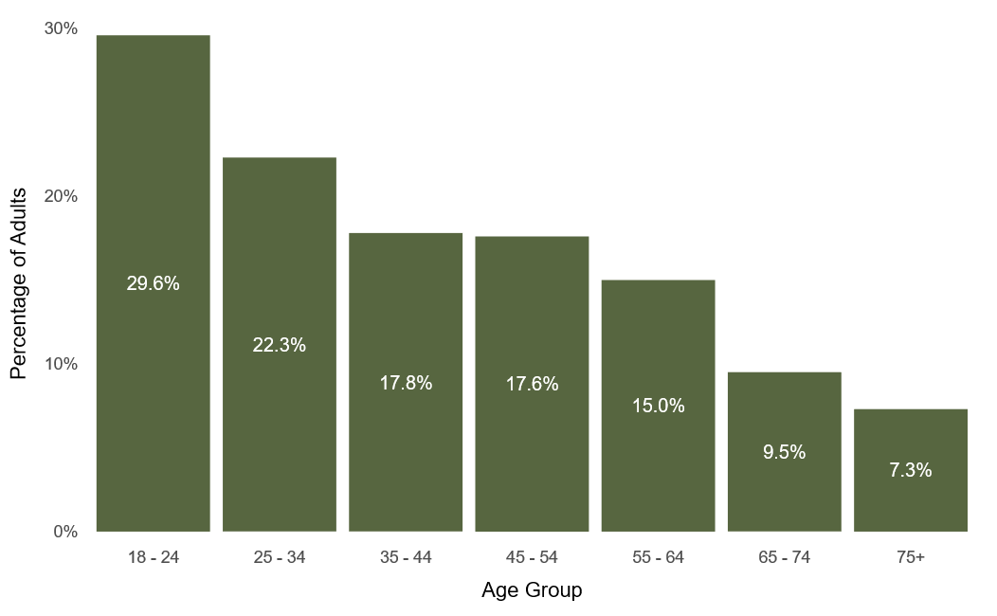
Adult Mental Health is Increasingly Poor for Some Groups
Figure 16. Percentage of individuals self-reported to have poor mental health by age, Michigan, 2023
Notes:
In 2023, the 37th annual Michigan Behavioral Risk Factor Survey (MiBRFS) found that an estimated 17.1% of the surveyed adults reported poor mental health in the last 30 days (see Figure 16) (Michigan Department of Health and Human Services, 2023). Poor mental health rates were higher for younger, female, non-White, higher-income, uninsured, and adults with disabilities. Additionally, reported poor mental health among adults has been increasing since 2018, while in years prior, the rates would fluctuate from time to time. According to the study, 15.3% of the 387 surveyed Lenawee County adult residents experienced poor mental health between 2021–2023 (Tian and Kleyn, 2025).

Slide 18
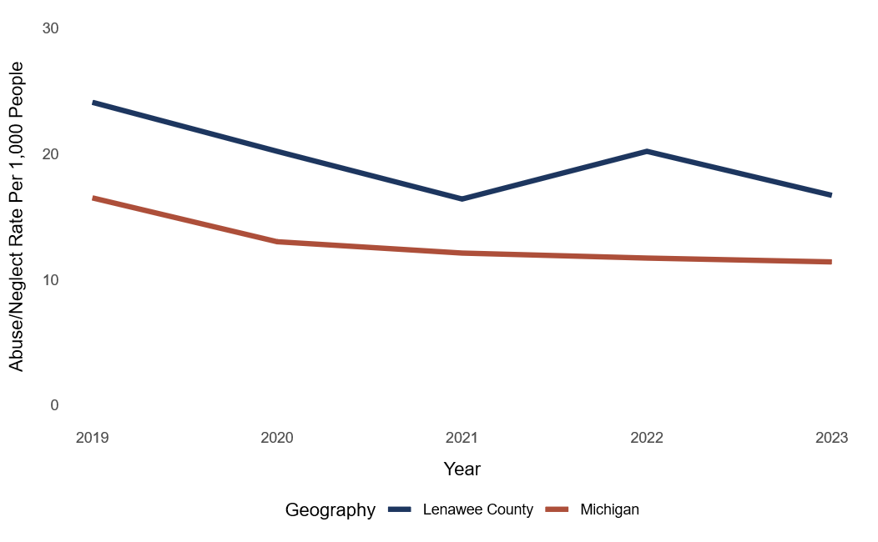
Child Abuse & Neglect Rates are Higher in Lenawee County Than in Michigan
Figure 17. Child abuse/neglect rate per 1,000 people, 2019–2023
Notes:
From 1997 to 2017, the child abuse and neglect rate increased in both Lenawee County and Michigan. From 2017 to 2024, this rate has decreased in both Lenawee County and Michigan (see Figure 17). As of 2024, an estimated 16.6 out of every 1,000 children in Lenawee County have experienced abuse or neglect, a rate higher than that of Michigan (11.4) (Michigan Department of Health and Human Services, Children’s Protective Services, 2025).
Even if a child’s situation is not considered severe enough to be placed in foster care, many children who experience ACEs are more susceptible to struggling with poor mental health later in life. Creating a safe and stable environment is vital for preventing child abuse and neglect and intergenerational trauma (U.S. Centers for Disease Control and Prevention, 2024).

Slide 19
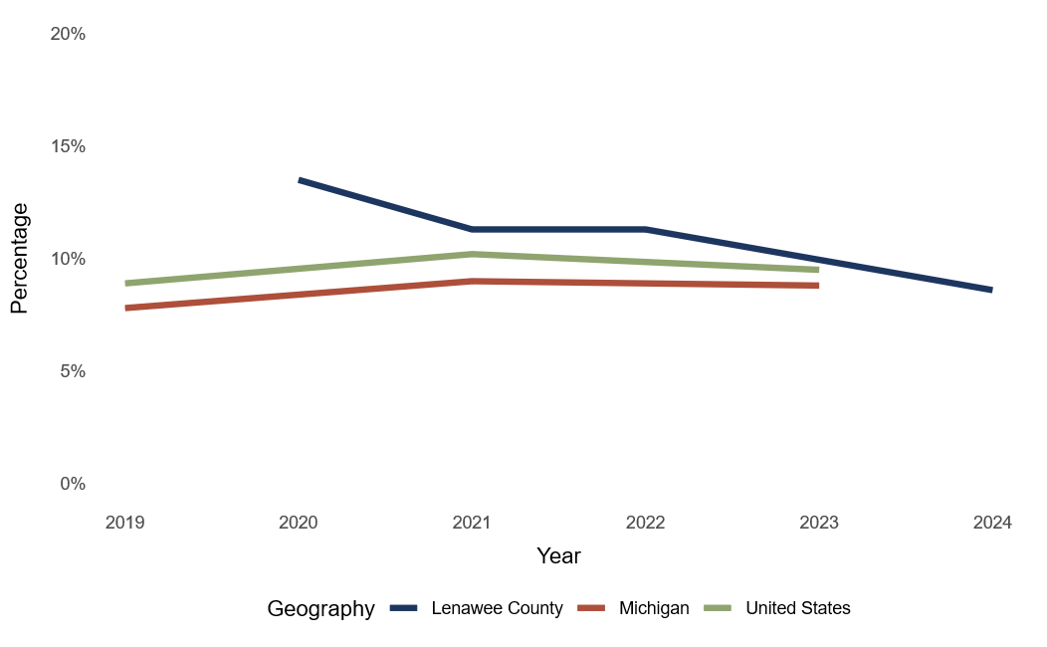
Youth Suicide Rates are Declining in Lenawee County
Figure 18. Percentage of high school students who attempted suicide one or more times during the past 12 months, 2019-2024
Notes:
In Lenawee County, on average, older children (9th–12th grade) have higher rates of experiencing mental health concerns surrounding feelings of sadness, suicidal ideation, and suicide attempts (Dake & Wielinski et al., 2021). Of the surveyed 9–12th-graders, 42% have felt sad or hopeless almost every day for two or more weeks in a row so that they have stopped doing usual activities in the past 12 months while 30% of the 7th graders surveyed have felt the same (Dake & Wielinski et al., 2021). Of students who participated in the Michigan Profile for Healthy Youth (MiPHY) survey, 8% of 9th –12th-grade students and 10% of 7th-grade students reported having attempted suicide between 2019 and 2020 (See Figure 18; Dake & Wielinski et al., 2021). Dake and Wielinski emphasize that these rates should not be taken as representative of all school districts in Lenawee County as it only represents those who opted to take the survey.
The Robertson Brain Health Pilot Program is working to address these concerns amongst law enforcement officials (O’Neill, 2025). In addition, the Lenawee Intermediate School District will provide students with assistance via the iWellness platform through the FY25 State School Aid Act. This program will allow students to access support services at little to no cost (Pfund, 2025).

